Slide 1
WhatsUrSay?
Team Name:
DSEs (D Software Engineers)
Team Members:
Abhinav Bhandaram
Rajashekhar Korakoppula
Nikhitha Kaza
Shanmukh Madhavarapu
Sreedevi Koppula

Slide 2
Agenda
What & Why?
Team Members & Responsibilities.
Development Environment
Project Directory Structure
Scope of the Project.
PERT chart
Gantt chart
Risk Management / Contingency Plan

Slide 3
What & Why?
A centralized place for all the polling and survey needs of an organization.
Users can create, update, participate and delete polls/surveys.
Public/Private polls/surveys. Polls/Surveys can be public i.e. open to all for participation or private polls/surveys open for a specific group of users.
Polls/Surveys are related to a category.
Dashboard view of all polls/surveys.
Some polls/surveys or feedbacks are still being conducted using papers.
WhatUrSay would provide an easy and user friendly way to create, participate and result publishing of polls/surveys.
It can also be used to create feedback surveys.
Anonymous participation option.

Slide 4
Team Members & Responsibilities
Abhinav Bhandaram (Team Lead): UI Developer, Architect
Shanmukh Madhavarapu: UI/Backend Developer
Rajashekhar Korakoppula: Backend Developer
Nikhitha Kaza: Backend/Middle tier Developer

Slide 5
Development Environment
OS: Windows
Programming Languages: C#, Typescript
Database: MySql
UI and Javascript Frameworks: Bootstrap, Angular JS, HTML, CSS, Jquery
Server side Technologies: ASP.NET MVC Web API, ASP.NET Core

Slide 6
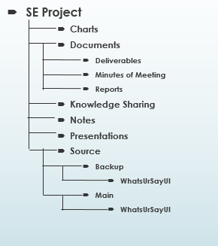
Project Directory Structure

Slide 7
Scope of the Project
Registration form
Dashboard for each user
User Roles
Admin (A)
Group leader (L)
Normal User (U)
Public and Private Polls/Surveys
Results on dashboard
Notifications to the users
Visualization of the results

Slide 8
Scope of the Project (cont..)
User Role | Privilege to Change Role | User Groups | User Group Members | Polls/Surveys | Results
Admin (A) | Yes. ‘U’ to ‘L’ | Create Remove Update Member | Assign a group leader Can’t add / remove members | Create Delete Update Participate | Publish / View
Group Leader (L) | No. | Create Remove Update Member | Add / remove | Create Delete Update Participate | Publish / View
Normal User(U) | No | Member | - | Participate | View

Slide 9
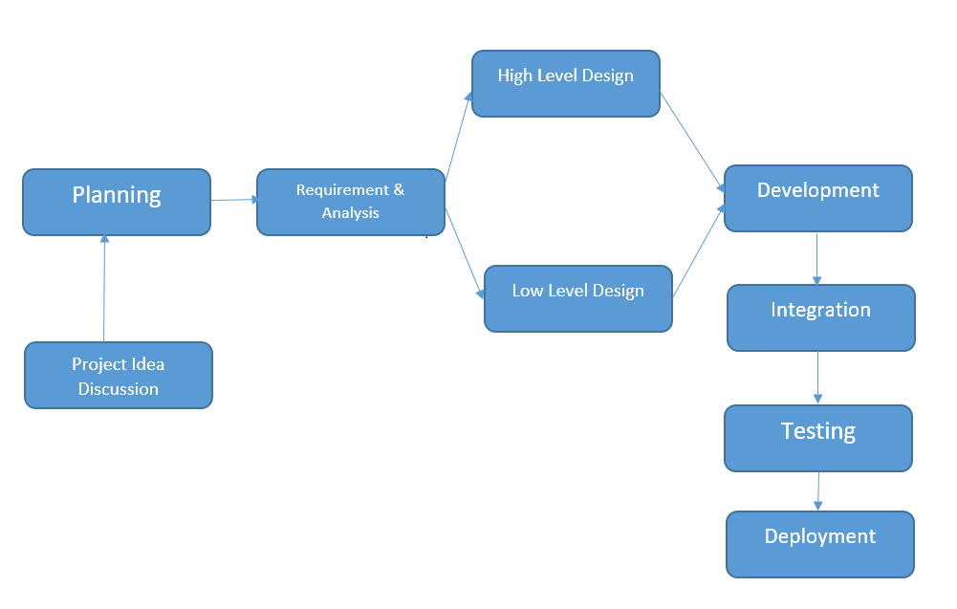
PERT chart

Slide 10
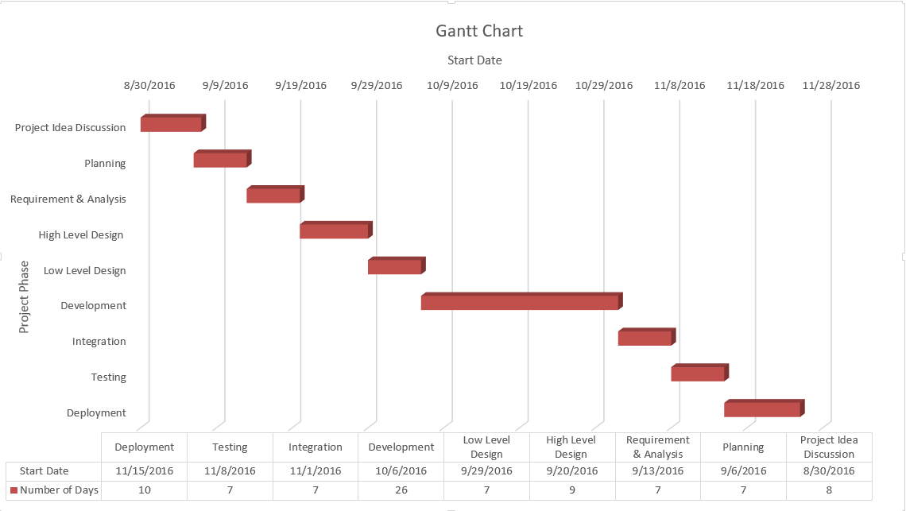
Gantt chart

Slide 11
Risk Management / Contingency Plan
S.NO | Risks | Monitoring | Contingency Plans
1 | Misunderstanding of requirements. | Code developed by one developer is tested by another to verify the correctness of functionalities. | At each phase code is tested. If a developer misunderstood requirements and coded the same then recoding is done as per correct requirements while other developers share extra work.
2 | Missing deadlines. | Percentage of work done is calculated to understand if it is with in timelines as per schedule | Reason is identified. If there is a medical emergency, then amount of work is shared among other developers.
 |  |  | If a developer is less productive then training is given to cope up.

Slide 12
Risk Management / Contingency Plan (Cont)
S.No | Risks | Monitoring | Contingency Plans
3 | Lack of Technical Knowledge. | In every team meeting technologies to be implemented in current phase are discussed to understand if developers has enough knowledge to start work. | Training is given for required technologies.
4 | Conflicts among developers. | Before starting to work on an activity or a module, opinion on approach to implement is taken from each developer. | Advantages and disadvantages of each approach is discussed and appropriate approach is selected.
5 | Low quality. | Will keep track of number of defects found at end of each activity and analyze quality of code. | Code quality is checked at end of each week. Defects are classified and root causes for defects are analyzed and appropriate action is taken based on metrics.

Slide 13


